Slide 1
DSCI 101 – Midterm Review

Slide 2
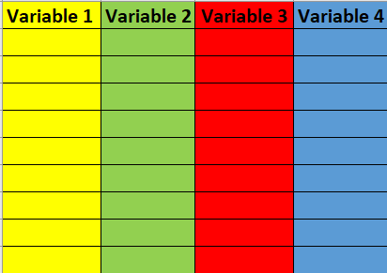
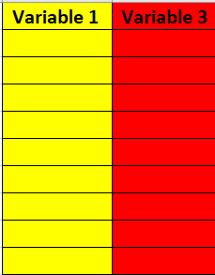
Data Wrangling – select()

Slide 3
Descriptions | Codes
Choose specific column name from the data frame | new_data <- data %>% select(Variable1, Variable3)
Select Columns by Name Patterns: use special helper functions like `starts_with()`, `ends_with()`, `contains()`, `matches()`, and `everything()` to select columns based on their names.
Exclude Columns: To exclude specific columns, you can use the "-" (minus) sign before the column name. | new_data <- data %>% select(-Variable2,-Variable4)
Select Columns by Index and Range: | new_data <- data %>% select(c(1,3))

Slide 4
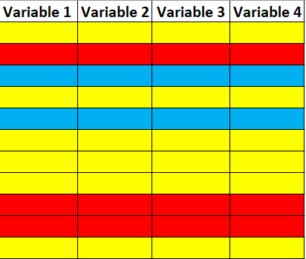
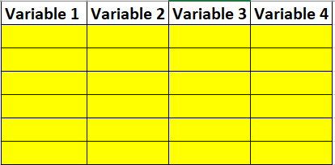
Data Wrangling – filter()

Slide 5
Descriptions | Codes
Simple Conditions - greater than (`>`), less than (`<`), or equal to (`==`) | new_data <- data %>% filter(Variable1 > 30) new_data <- data %>% filter(Variable2 == "yes")
Multiple Conditions - You can combine conditions using logical operators like `&` (AND) and `|` (OR). | new_data <- data %>% filter(Variable1 > 30 & Variable2 < 50000) new_data <- data %>% filter(Variable1 > 30 | Variable2 < 50000)
Exclusion - to exclude certain rows, you can use the `!=` operator (not equal to). | new_data <- data %>% filter(Variable4 != 30)
Filter rows based on vector of conditions - The `%in%` operator is useful for filtering rows with values in a specified vector. | new_data <- data %>% filter(Variable3 %in% c("bananas", "grapes"))

Slide 6
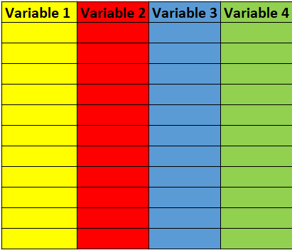
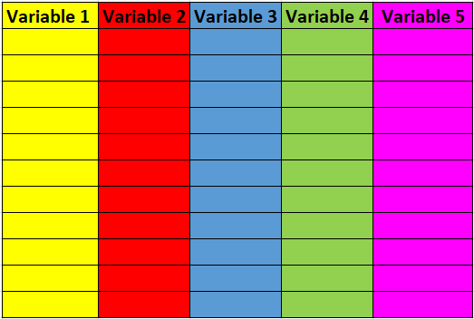
Data Wrangling – mutate()

Slide 7
Descriptions | Codes
Create a new variable calculated from another variable | new_data <- data %>% mutate(Variable5 = Variable2 / 12)
We can use other functions within mutate to help us make the new variable like `ifelse()`. | new_data <- data %>% mutate(Variable5 = ifelse(Variable1 > 30, "Old", "Young"))
If you have multiple condition you can use the `case_when()` function and list out your possible options. | new_data <- data %>% mutate(Variable5 = case_when( Variable1 < 30 ~ "Young", Variable1 >= 30 & Variable1 <= 50 ~ "Middle-aged", Variable1 > 50 ~ "Old", TRUE ~ "No Category" ))

Slide 8
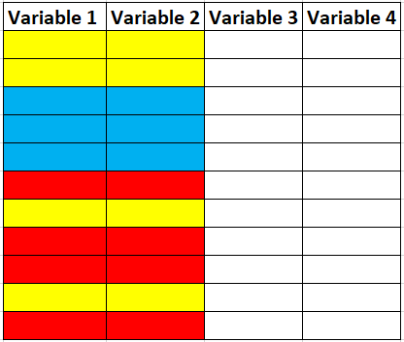
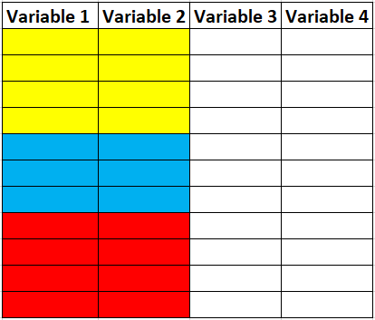
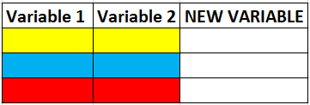
Data Wrangling – summarise() & group_by
group_by()
summarise()

Slide 9
Descriptions | Codes
Compute different statistics (mean, median..etc) grouped by different variables. | new_data <- data %>% group_by(Variable1, Variable2) %>% summarise(NEW_VARIABLE1 = mean(Variable1), NEW_VARIABLE2 = median(Variable2))
If you do not group_by, it will make a computation on the entire column: | new_data <- data %>% summarise(NEW_VARIABLE1 = mean(Variable1), NEW_VARIABLE2 = median(Variable2))

Slide 10
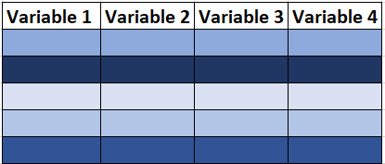
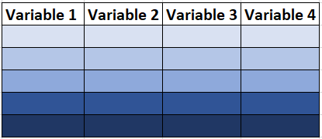
Data Wrangling – arrange()

Slide 11
Descriptions | Codes
Arrange in ascending order (smallest to largest) | new_data <- data %>% arrange(Variable1)
Arrange in descending order (largest to smallest) | new_data <- data %>% arrange(desc(Variable1))

Slide 12
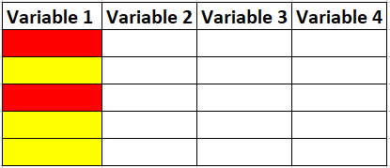

Data Wrangling – count()

Slide 13
Descriptions | Codes
Count the occurrences of each "category" | new_data <- data %>% count(Variable1)
Can achieve the same thing as count using summarize. With summarize you can name the new variable whatever you want. With count, it automatically calls it “n”. | new_data <- data %>% group_by(Variable1) %>% summarise(NEW_VARIABLE = n())

Slide 14
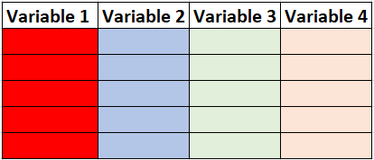
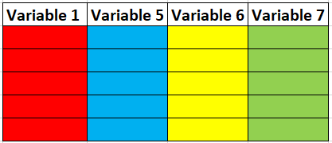
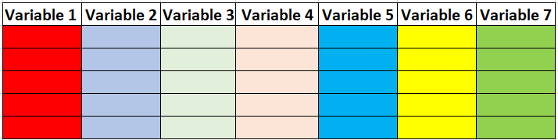
Joining Datasets

Slide 15
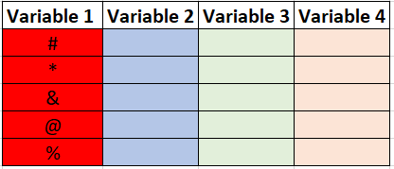
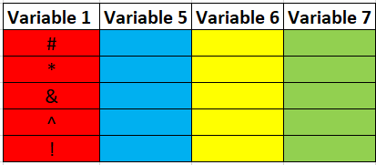
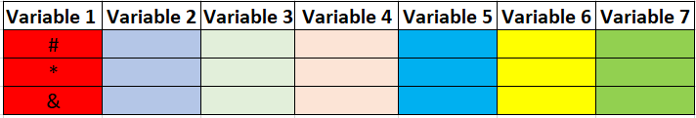
Joining Datasets – inner_join()
new_data <- left_data %>%
inner_join(right_data, by = c("Variable1" = "Variable1"))

Slide 16
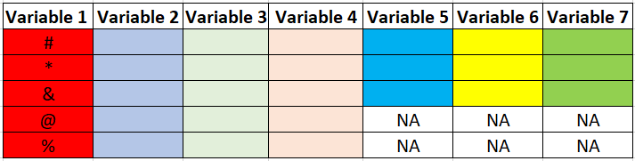
Joining Datasets – left_join()
new_data <- left_data %>%
left_join(right_data, by = c("Variable1" = "Variable1"))

Slide 17
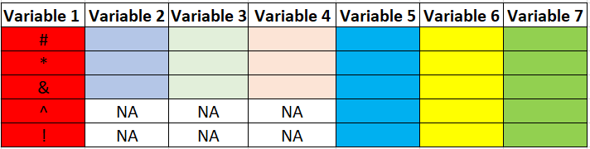
Joining Datasets – right_join()
new_data <- left_data %>%
right_join(right_data, by = c("Variable1" = "Variable1"))

Slide 18
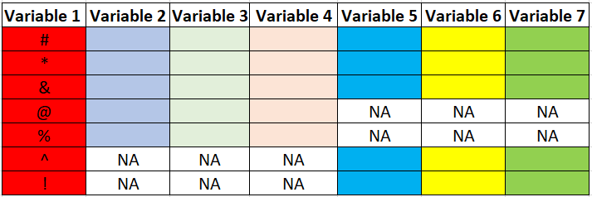
Joining Datasets – full_join()
new_data <- left_data %>%
full_join(right_data, by = c("Variable1" = "Variable1"))

Slide 19
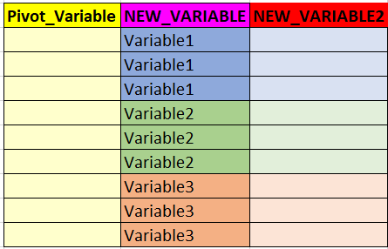
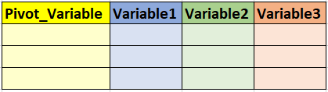
Pivot – pivot_longer() & pivot_wider
pivot_longer()
pivot_wider()
new_data <- data %>%
pivot_longer(cols = -Pivot_Variable,
names_to = “NEW_VARIABLE",
values_to = “NEW_VARIABLE2")
new_data <- data %>%
pivot_wider(names_from = NEW_VARIABLE,
values_from = NEW_VARIABLE2)

Slide 20
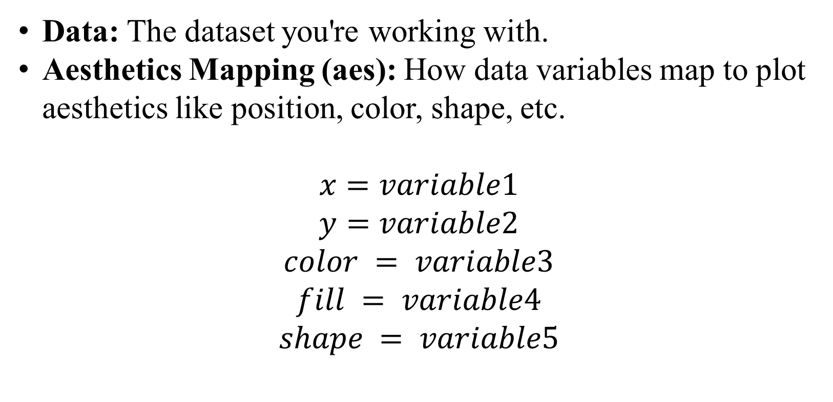
Data Visualization – ggplot()
Data: The dataset you're working with.
Aesthetics Mapping (aes): How data variables map to plot aesthetics like position, color, shape, etc.
$$x=variable1$$
$$y=variable2$$
$$color = variable3$$
$$fill = variable4$$
$$shape = variable5$$

Slide 21
Data Visualization – ggplot()
Geometric Objects (geom): The visual elements to represent the data (points, lines, bars, etc.).
    geom_histogram()
    geom_density()
    geom_boxplot()
    geom_line()
    geom_bar()
    geom_point()

Slide 22
Data Visualization – ggplot()
Facets (facet_wrap or facet_grid): Splitting data into subplots based on a variable.
    facet_wrap(~ Variable1)
    facet_grid(Variable1 ~ Variable2)

Slide 23
Data Visualization – ggplot()
Theme: Controlling the overall appearance of the plot.
    theme_gray()
    theme_bw()
    theme_minimal()
    theme_void()

Slide 24
Data Visualization – ggplot()
Add ons
  coord_flip()
  geom_smooth(method = "lm", se = FALSE) geom_smooth(method = "loess", se = TRUE)
  scale_fill_manual(values = c("red", "green", "blue"))
  scale_color_manual(values = c("red", "green", "blue"))
  labs()

Slide 25
For loops & If/Else Statements
x<-NA
y<-NA
for (i in 1:5) {
y[i] <- 1+i
if (y[i]>3) {
x[i] <- "Yes"
}else if (y[i]<3){
x[i] <- "No"
}else{
x[i]<-"Maybe"
}
}
y
x

Slide 26
Functions
circumference <- function(r){
  c = 2*pi*r
  return(c)
}
circumference(5)
circumference(r = 5)

